Slide 1

Intro to Quantum Mechanics and DFT
Niels Bohr:
“For those who are not shocked when they first come across quantum theory cannot possibly have understood it”
June 13, 2022 – Mississippi State

Slide 2



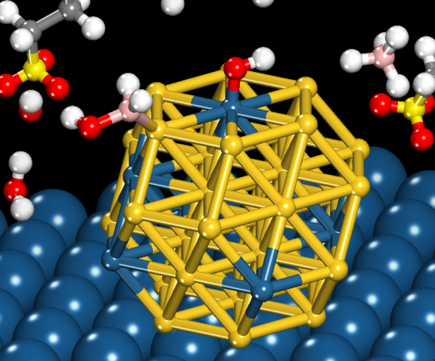
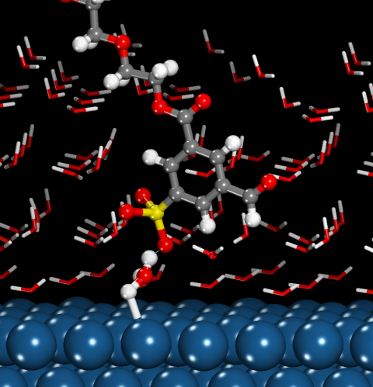


Mike Janik background
Undergraduate – Yale University
Process Engineer for Procter and Gamble for 3 years
Graduate – University of Virginia
Joined Penn State in Fall 2006
Research – Atomistic modeling of catalysis, electrochemical systems
Classes taught: Thermodynamics, Mass Transfer, Reactor Design and Kinetics, Electrochemical Engineering, DFT Theory and Practice, Chemical Energy Tech.
Family and Hobbies –
My wife Shannan and I have a 16 year old son Sam
and a 12 year old son Joseph

Slide 3


Your background – from Survey
Notes:
3

Slide 4
Quantum Mechanics Basics – Our Objectives
Survey 1-1.5 semesters of QM in <50 minutes
Students should be able to:
Explain the general mathematical structure of quantum mechanics
Identify the major computational choices involved in using computational quantum mechanical methods
Apply computational quantum mechanics to a problem of interest
We will have to skip much of the math and breadth of methods, but will aim to meet the above objectives such that you can comprehend research using computational quantum mechanical techniques and be intelligent users of available computational methods.
Notes:
4

Slide 5
Brief History of Quantum Mechanics Leading to the Schrodinger Equation
Time-Independent Schrodinger Equation, and the Postulates of QM
Particle in a Box – One Dimension, Single Particle Solution to Schrodinger Eqn.
Hydrogen Atom – Determining Orbitals from Schrodinger Equation

Slide 6
Brief History of Quantum Mechanics Leading to the Schrodinger Equation
Why can’t we just use F=ma to represent the physics of an electron?
What observations motivated development of the equations of quantum mechanics?
(we are going to race through the “history” slides after this one – they are there for reference)

Slide 7

Notes:
7

Slide 8
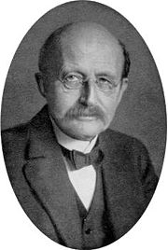
The limits of classical physics – the ultraviolet catastrophe
Max Planck (1858-1947)

Slide 9
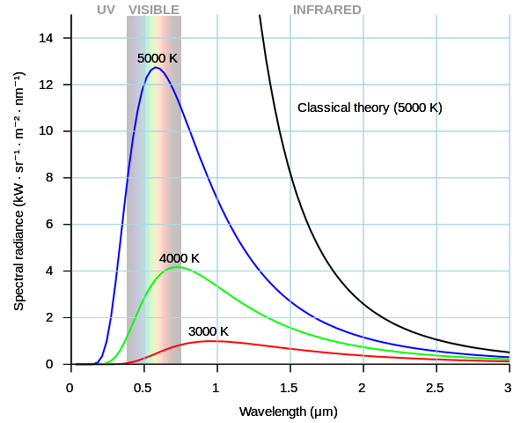
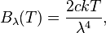
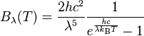
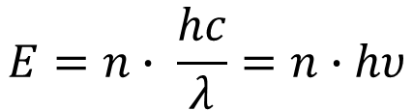
Classical Theory Fails to Describe High Frequency Region of Blackbody Emission Spectrum
Prob(E) ~ exp(-E/k_{b}T)
$$E=n∙ \frac{hc}{λ}=n∙hυ$$
Energy is restricted to integer multiples!

Slide 10
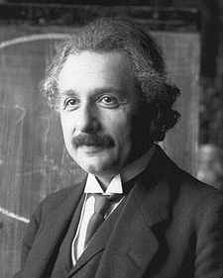
Explanation of Planck’s correction: quantum nature of light
Photoelectric effect
UV light
Electron emission
Albert Einstein (1879-1955)
Increase in light intensity does not increase the kinetic energy of the electrons
Increase in light frequency does increase the electron kinetic energy

Slide 11
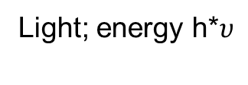
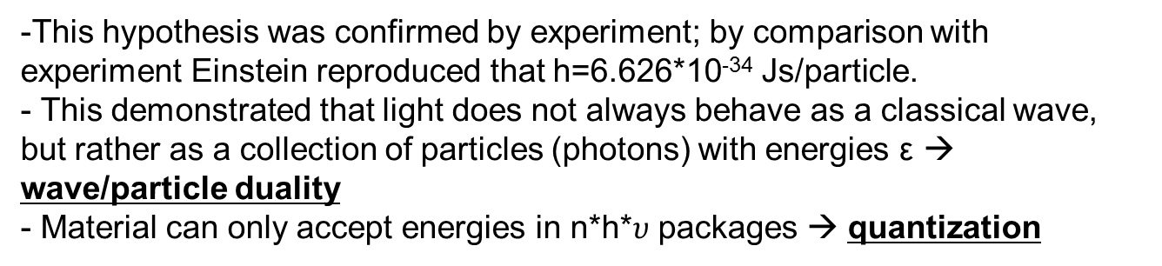
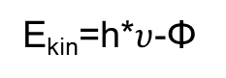
Einstein hypothesis for the photoelectric effect (1905)
Light; energy h*$υ$
E_{kin}=h*$υ$-Φ
-
-
-
-
Minimum energy needed to release electron from material=Φ (work function)
Electron in material
Electron on emission threshold
Emitted electron
This hypothesis was confirmed by experiment; by comparison with experiment Einstein reproduced that h=6.626*10⁻³⁴ Js/particle.
This demonstrated that light does not always behave as a classical wave, but rather as a collection of particles (photons) with energies ε → wave/particle duality
Material can only accept energies in n*h*$υ$ packages → quantization
Notes:
Einstein’s “light quanta” was not well accepted, though it helped explain experimental phenomena (energy is ejected electron is linearly dependent on incoming freq, amount ejected depended on intensity).
“Particle” – need to think of the light as containing individual “photons” – entities like particles, not just as a wave varying in amplitude

Slide 12

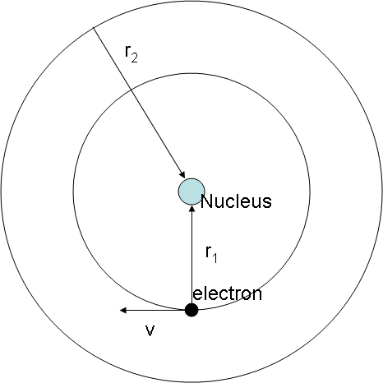

The Bohr atom and the
de Broglie-hypothesis for matter waves
Bohr hypothesis: Fixed Angular Momentum L=m_{e}vr=n*h/2π.
Einstein hypothesis for photoelectric effect: wave/particle duality of light.
de Broglie hypothesis: Matter also has a wave/particle duality; light (as in not heavy) particles (like electrons) have a significant wave character (1924 doctoral thesis).
Explains the Bohr hypothesis; electrons can only occupy orbits that have a length that fits their wavelength
Louis de Broglie
(1892-1987)
λ_{electron}
Orbit length=n*λ (n=2)

Slide 13
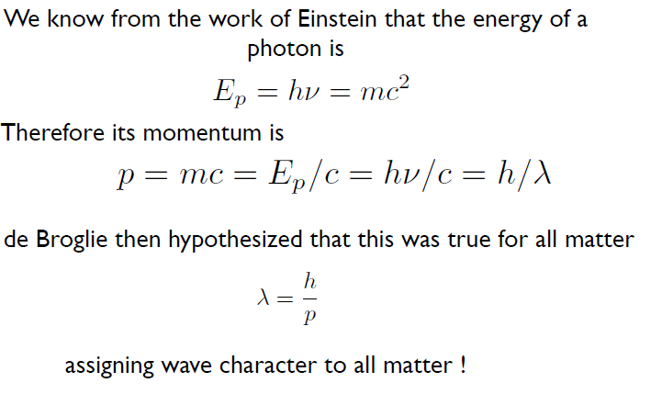
Wave-Particle Duality

Slide 14

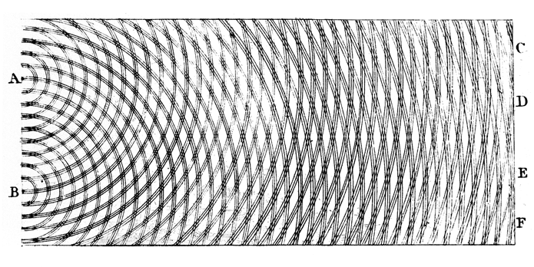
Prove for wave character of light and matter: Diffraction
Interference pattern
Light interference gives diffraction patterns (Thomas Young, 1803) indicating wave-character of light.

Slide 15
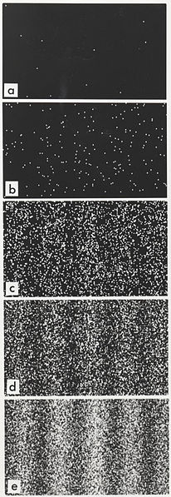
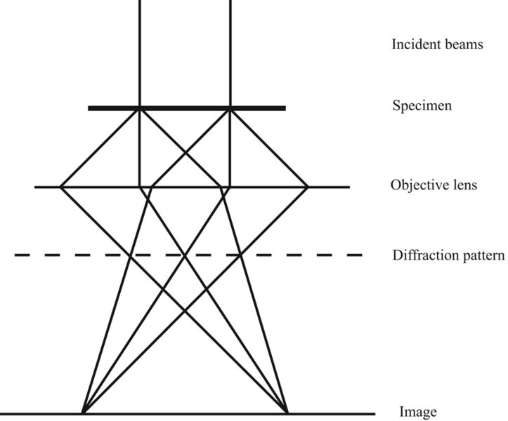

Electron Diffraction
The observation of electron diffraction confirmed the de Broglie hypothesis
The de Broglie-wavelength of a particle signifies the relative importance of its wave and particle-nature
Transmission electron microscope electron diffraction pattern
George Thomson, Clinton Davisson and Lester Germer (1927)

Slide 16
Brief History of Quantum Mechanics Leading to the Schrodinger Equation
Time-Independent Schrodinger Equation, and the Postulates of QM
Particle in a Box – One Dimension, Single Particle Solution to Schrodinger Eqn.
Hydrogen Atom – Determining Orbitals from the Schrodinger Equation

Slide 17
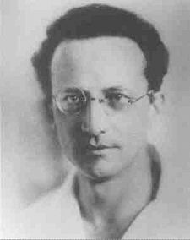
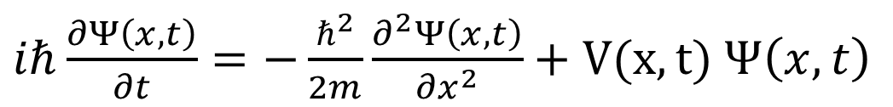
The Schrödinger equation: postulate that the states of an electron are the solution of a wave equation
Erwin Schrödinger
(1887-1961)
Electrons move in specific orbitals due to their partial wave-character (Bohr, de Broglie)
As such, we might expect that we can model the behavior of events at the atomistic level using a wave-equation:
In 1926 Erwin Schrödinger suggested that a wave equation Ψ could be used to describe matter waves:
$iℏ\frac{∂Ψ\left(x,t\right)}{∂t}=−\frac{ℏ^{2}}{2m}\frac{∂^{2}Ψ\left(x,t\right)}{{∂x}^{2}}+V(x,t)$ $Ψ\left(x,t\right)$

Slide 18

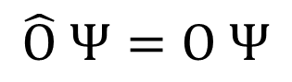
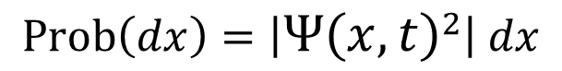
The postulates of Quantum Mechanics – the wavefunction is the state function of a quantum system
Laurendeau, page 81
These postulates can not be proved; their proof is in the fact that they have resulted in a successful solution of real-world problems
The state of any quantum mechanical system can be specified by a function Ψ(x,t), called the wave function of the system. The quantity ΨΨ*dx is the probability that the position x of the particle lies between x and Δx :
There exists some operator that can be used to determine any observable value of a system from the wavefunction
The observable variable is given by:
$$Prob\left(dx\right)=\left|{Ψ\left(x,t\right)}^{2}\right| dx$$
We refer to $\left|{Ψ\left(x,t\right)}^{2}\right|$ as the “density”
$$\hat{\text{O}} Ψ=O Ψ$$
→Weighted Average over all space

Slide 19
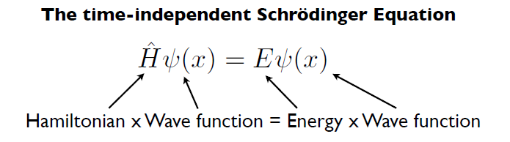
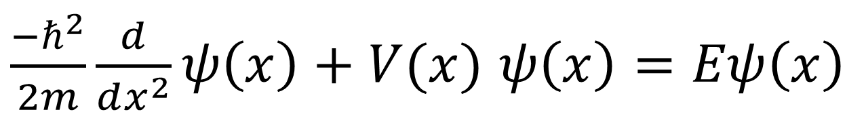
Schrodinger’s equation looks like an energy balance (in operator language…)
Hamiltonian operator – the set of mathematical operations that need to be done to the wavefunction to return the energy times the wavefunction
Kinetic Energy + Potential Energy = Total Energy
Need V(x) function, rewrite in 3d…..

Slide 20
Brief History of Quantum Mechanics Leading to the Schrodinger Equation
Time-Independent Schrodinger Equation, and the Postulates of QM
Particle in a Box – One Dimension, Single Particle Solution to Schrodinger Eqn.
Hydrogen Atom – Determining Orbitals from the Schrodinger Equation

Slide 21
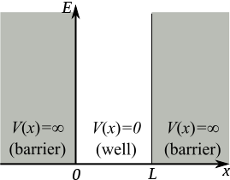
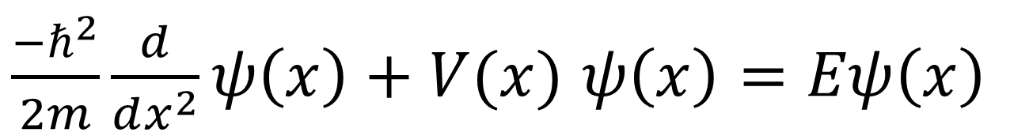
Particle in a (one dimensional) box – a simple physical system that illustrates the consequences of a quantum treatment

Slide 22
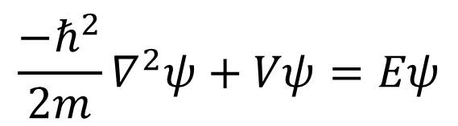
Solve for ψand E (time probably won’t allow – consequences key on next slides)
$$\frac{{−ℏ}^{2}}{2m}∇^{2}ψ+Vψ=Eψ$$
Notes:
E is a function of “n” → introduces idea of quantum numbers, forms a set of solutions with quantized energies (i.e. one atom has infinite number of theoretical orbitals)
Go to excel plot of E’s vs. L → delta E goes to zero as L increases, thus explaining why quantized energy states seemingly disappear at the classical level

Slide 23
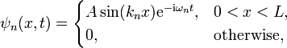
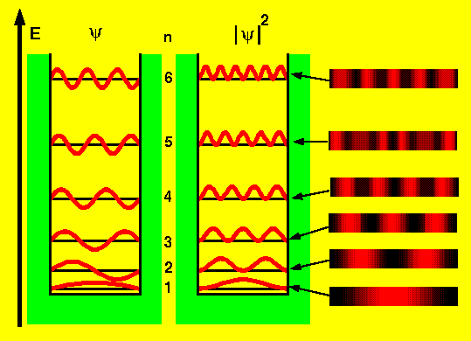
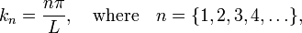
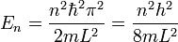
Particle in a box – Energy and wavefunctions

Slide 24
Last slide has the mathematical solutions to a particle in a box
What is “shocking” from the solutions of the particle in a box problem?
There are “nodes” -places where the wavefunction = 0
Niels Bohr:
“For those who are not shocked when they first come across quantum theory cannot possibly have understood it”
Notes:
E is a function of “n” → introduces idea of quantum numbers, forms a set of solutions with quantized energies (i.e. one atom has infinite number of theoretical orbitals)
Go to excel plot of E’s vs. L → delta E goes to zero as L increases, thus explaining why quantized energy states seemingly disappear at the classical level

Slide 25
Last slide has the mathematical solutions to a particle in a box
What is “shocking” from the solutions of the particle in a box problem?
Energy levels are quantized! We can not give the particle any energy we want
The wavefunction has nodes! In level 2, 50% chance particle is on left side, 50% chance it is on right side, but 0% chance it ever exists at the exact middle.
Zero point energy – there is no “0” state of rest, the ground state still has energy and moves
Niels Bohr:
“For those who are not shocked when they first come across quantum theory cannot possibly have understood it”
Notes:
E is a function of “n” → introduces idea of quantum numbers, forms a set of solutions with quantized energies (i.e. one atom has infinite number of theoretical orbitals)
Go to excel plot of E’s vs. L → delta E goes to zero as L increases, thus explaining why quantized energy states seemingly disappear at the classical level

Slide 26
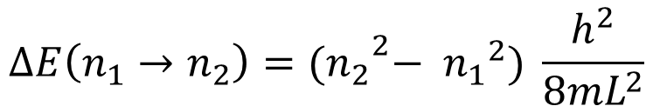
Quantum to Classical Transition
$$ΔE\left(n_{1}→n_{2}\right)={{(n}_{2}}^{2}− {n_{1}}^{2}) \frac{h^{2}}{8mL^{2}}$$
Electron in a 1 angstrom box:
$ΔE\left(n_{1}→n_{2}\right)={(2}^{2}− 1^{2}) \frac{{{(6.626x10}^{−34})}^{2}}{8{(9.11x10}^{−31}) {{(10}^{−10})}^{2}(1.6x{10}^{−19} )}$ = 4.52 eV
Electron in a 1 meter box:
$ΔE\left(n_{1}→n_{2}\right)={(2}^{2}− 1^{2}) \frac{{{(6.626x10}^{−34})}^{2}}{8{(9.11x10}^{−31}) 1^{2}(1.6x{10}^{−19} )}$ = 1.13x10⁻¹⁸ eV
Baseball in a 1 meter box:
$ΔE\left(n_{1}→n_{2}\right)={(2}^{2}− 1^{2}) \frac{{{(6.626x10}^{−34})}^{2}}{8(0.15) 1^{2}(1.6x{10}^{−19} )}$ = 6.86x10⁻⁴⁸ eV

Slide 27
Brief History of Quantum Mechanics Leading to the Schrodinger Equation
Time-Independent Schrodinger Equation, and the Postulates of QM
Particle in a Box – One Dimension, Single Particle Solution to Schrodinger Eqn.
Hydrogen Atom – Determining Orbitals from the Schrodinger Equation

Slide 28

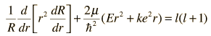
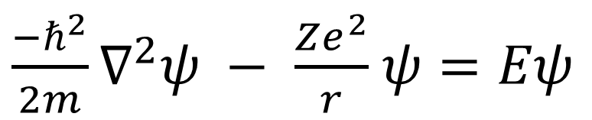
The Hydrogen Atom – now we add the nucleus-electron Coulomb as the V term. Equation is still analytically solvable
V(r) – from Coulomb’s law, gives a one particle, central force problem
$\frac{{−ℏ}^{2}}{2m}∇^{2}ψ − \frac{Ze^{2}}{r}$ $ψ=Eψ$
Z = positive charge on nuclei (1 for hydrogen), e = elementary charge, r = distance from the nuclei
Convert to spherical coordinates, “2 or 3 chapters of math” and can show:
where the radial solution is multiplied by the spherical harmonics (eigenfunctions of the square of the magnitude of the orbital angular momentum of a single particle)

Slide 29
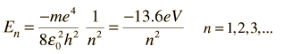
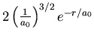
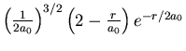
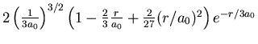
The Hydrogen Atom – Radial functionals all exponentially decay with respect to distance from nucleus (r)
R(r) =
n=1 solutions only for l=1
(s orbitals)
n=2
solutions for l=0,1
(s, p)
n=3
solutions for l=0,1,2 (s, p, d)

Slide 30
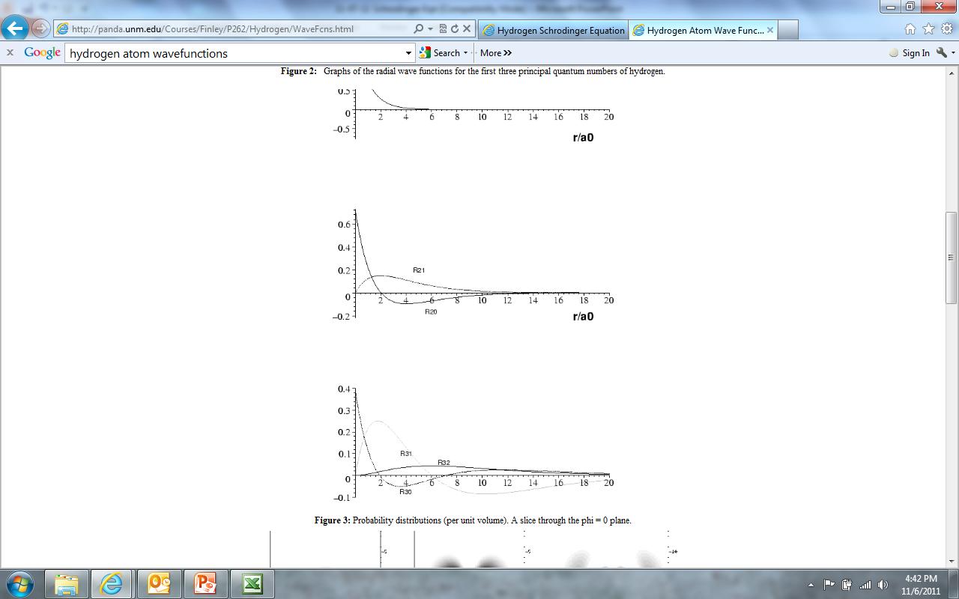
The Hydrogen Atom – Radial wavefunctions all exponentially decay with respect to distance from nucleus (r)
s
n=1
n=2
n=3
2s
2p
3s
3p
3d

Slide 31
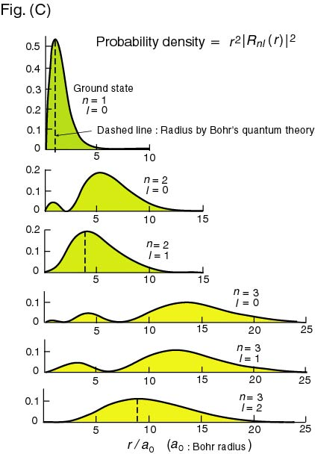
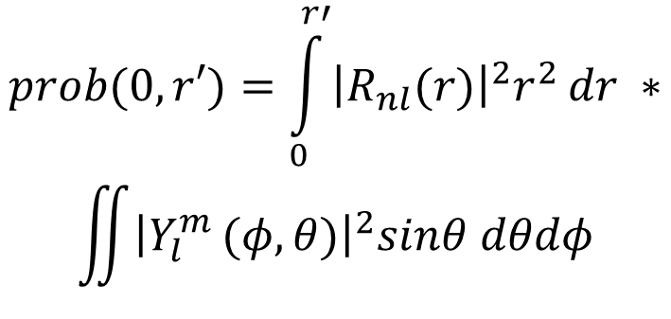
The Hydrogen Atom – Radial Distribution Functions
Probability of finding the electron a given distance from the nuclei
$$prob(0,r′)=\int_{0}^{r′}{{\left|R_{nl}(r)\right|}^{2}r^{2}}dr ∗$$
$$\iint{{\left|Y_{l}^{m }(φ,θ)\right|}^{2}sinθ dθdφ}$$

Slide 32
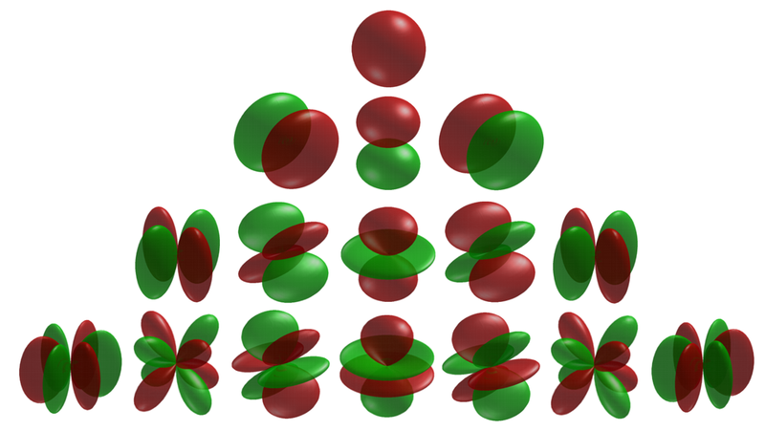
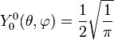
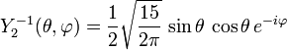
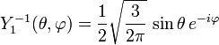
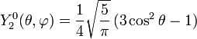
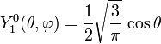
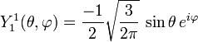
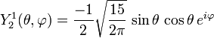
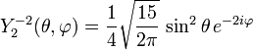
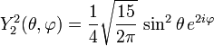
The Hydrogen Atom – Spherical Harmonics part of solution
l = 0, 1, 2, …
m = -l, …, 0, …,l
l = s, p, d, f
m = p_{x}, p_{y}, p_{z}

Slide 33
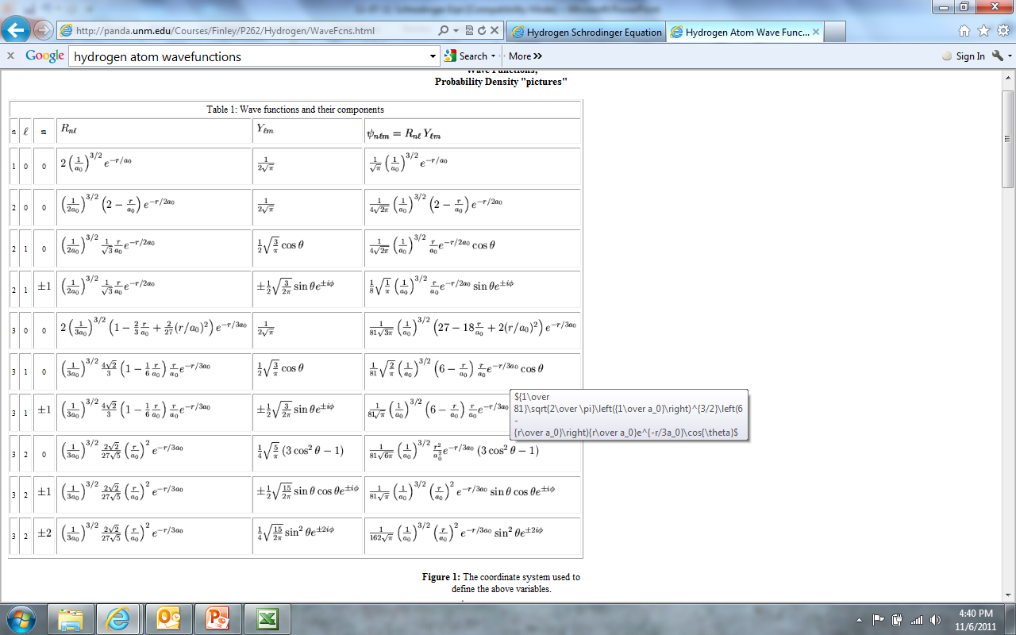
The Hydrogen Atom – spherical harmonic x radial
These are analytical, spatial functions (ψ(x,y,z) or ψ(r,θ,φ)

Slide 34
Key point for QM basics:
Schrodinger’s equation is a differential equation on the “wavefunction” with eigenvalues giving the energy for each wavefunction
The “wavefunction” embeds all state information of the electron, but itself doesn’t have a physical meaning
Squaring the wavefunction gives the probability of finding an electron as a function of position
Though not the easiest differential equation to solve, solving Schrodinger’s equation for the H atom gives 1s, 2s, 2p, 3s, 3p, 3d, … functions. H wavefunctions are functions of space (x, y, z or r, θ,φ)

Slide 35


More than 1 electron: He atom Schrodinger Equation – not analytically solvable
KE electron e – nucleus KE nucleus electron-electron
Distance vectors between electron and nucleus)
Heavy atoms: Born-Oppenheimer approximation, removes KE nucleus term. In atomic units (ie, non-dimensionalized by constants):
Wavefunction now a function of x₁, y₁, z₁, x₂, y₂, z₂ (or r₁, θ₁, φ₁, r₂, θ₂, φ₂). Because of electron-electron term, this is not separable in any coordinate system. Must be solved by approximate methods.

Slide 36


“Exchange” and “Correlation” arise in solving for a multi-electron wavefunction. These are non-classical…..
Exchange – an additional energy term that comes from a wavefunction needing to be antisymmetric with respect to changing which electron is which. Leads to “Pauli exclusion principle”, and effectively raises energy beyond just e-e Coulomb repulsion
Correlation– an attractive interaction between electrons not captured by the average probability distribution, because electrons can “correlate” their motion. Important in all multi-electron systems, and the source of VDW interactions (ie, why Argon condenses…)

Slide 37
More than 1 electron: He atom Schrodinger Equation
KE electron e – nucleus KE nucleus electron-electron
Distance vectors between electron and nucleus)
Heavy atoms: Born-Oppenheimer approximation, removes KE nucleus term. In atomic units (ie, non-dimensionalized by constants):
Wavefunction now a function of x₁, y₁, z₁, x₂, y₂, z₂ (or r₁, θ₁, φ₁, r₂, θ₂, φ₂). Because of electron-electron term, this is not separable in any coordinate system. Must be solved by approximate methods.

Slide 38

Directions to take in finding an approximate solution for a multiple electron system:
“Wavefunction based” – we have the “right equation” but will need to find an approximate solution
“Density functional theory” – recast the problem to finding the total electron density rather than the set of wavefunctions
Try to write an equation for the total energy of the system using n(r) instead of wavefunctions. This isn’t quite as a large a “reset” as it initially seems, but let’s just review the underlying theory for now, afternoon we’ll then talk about executing computationally.

Slide 39



Slide 40
“Orbital-free density functional theory” – great in theory, but not very useful because we don’t know how to write the KE in terms of the density
Write all terms:
KE of electrons + electron-nuclear attraction + electron-electron repulsion
as functionals of the electron density F(ρ(x,y,z) = a functional
Issue:
Neon atom:
KE = 128.9 au
Exchange = -12.1 au
Correlation = -0.4 au
The KE is large, and unknown how to write in terms of the density. Very sensitive to how this is written.
Orbital free DFT comes across like force-field development with a complex function

Slide 41

Kohn-Sham equations re-invoke the (non-interacting) wavefunction for the kinetic energy term. Discuss more tomorrow….

Slide 42





Kohn-Sham density functional theory basics
nuclei-nuclei
Coulombic
electron kinetic energy
electron nuclei
Coulomb
electron electron
“average” Coulomb
electron exchange
+correlation

Slide 43
Kohn-Sham density functional theory basics
What does each term here represent?

Slide 44

Exchange-Correlation Functionals

Slide 45
Density Functional Theory Key Points
DFT considers the electron density the important function to find rather than the wavefunctions themselves. Hohenberg and Kohn theorems state that this is valid in defining the electronic structure of the ground state.
Kohn-Sham DFT re-invokes single electron wavefunctions, effectively allowing use of the kinetic-energy term from Schrodinger’s equation
Kohn-Sham DFT becomes easier to solve than basic wavefunction methods (ie, Hartree-Fock) and plausibly more accurate. The major disadvantage is the need for the “unknown” exchange and correlation functional
Many exchange and correlation functionals exist. The choice of which to use depends on the system of interest, previous testing of functionals on the system, and computational power available.

Slide 46


Slide 47




Hohenberg-Kohn theorem: key statements
The nondegenerate GS wave function is unique functional of GS density
GS energy is given expectation value of ground state wave function
Capelle, Brazilian Journal of Physics, 36, 1318-1343, 2006
neerajrai@che.msstate.edu

